Slide 2
Death to SQL Server! Long live SQL Server! How containerized SQL Server makes development easier
Michael Jolley
@michaeljolley

Slide 3
New talk. Who dis?

Slide 4




New talk. Who dis?
Software architect & developer for 20 years
Live-coding 3 days a week on Twitch
Auth0 Ambassador
Novice at exiting VIM

Slide 5
Docker?!? We don’t need no stinking dockers.

Slide 6
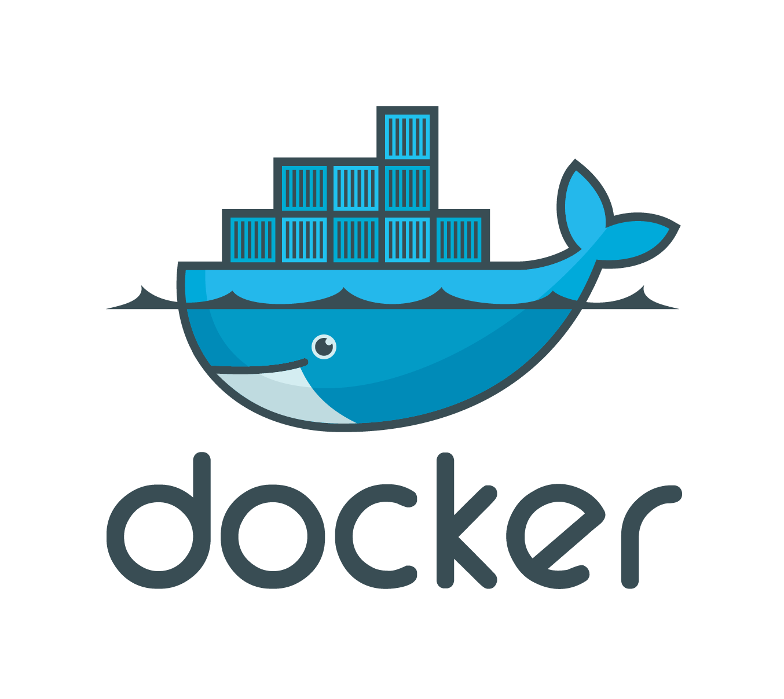
Docker?!? We don’t need no stinking dockers.
Similar isolation & allocation benefits to VMs
Virtualize O/S rather than hardware
Images are 10s/100s MBs versus GBs

Slide 7
Nobody puts SQL in a container* *Dirty Databasing

Slide 8

Nobody puts SQL in a container*
Zero footprint versus installed (GBs)
Cross-platform support
One less (big) attack vector
#notonmymachine
*Dirty Databasing starring Sean Hasselhoff

Slide 9
Show me the money …errrr, I mean the demo.

Slide 10
Spinning up SQL in a container
docker run -e 'ACCEPT_EULA=Y' -e 'SA_PASSWORD=DOTnetConf2019!' --name sql1 -d mcr.microsoft.com/mssql/server:2017-latest
-e 'SA_PASSWORD=DOTnetConf2019!’
-e 'ACCEPT_EULA=Y’
--name sql1
-d mcr.microsoft.com/mssql/server:2017-latest

Slide 11
Copying files in/out of the container
docker cp ClientGonnaClient.bak sql1:/var/opt/mssql/data/ClientGonnaClient.bak
First parameter is the source file
Second parameter
Container location should be styled as {container id/name}:{path}

Slide 12
Port forwarding & volume mapping
docker run -e 'ACCEPT_EULA=Y' -e 'SA_PASSWORD=DOTnetConf2019!' --name sql1 -p 1433:1433 -v D:/Sources/data:/var/opt/mssql/data
-d mcr.microsoft.com/mssql/server:2017-latest
-p 1433:1433
-v D:/Sources/data:/var/opt/mssql/data
Formatted as:
{host path}:{container path}

Slide 13
Thanks!
Slides / Source code / Additional Links http://bit.ly/dnc2019
@michaeljolley michaeljolley.com https://twitch.tv/theMichaelJolley

